Slide 1
Statistical Modelling with python
Rafaela Queiroz F. Cordeiro

Slide 2
Project steps
1. Connecting with City Bikes API
2. Connecting with Foursquare and Yelp APIs
3. EDA and Data Transformation
4. Hypothesis Test and Machine Learning Model (still in progress)

Slide 3
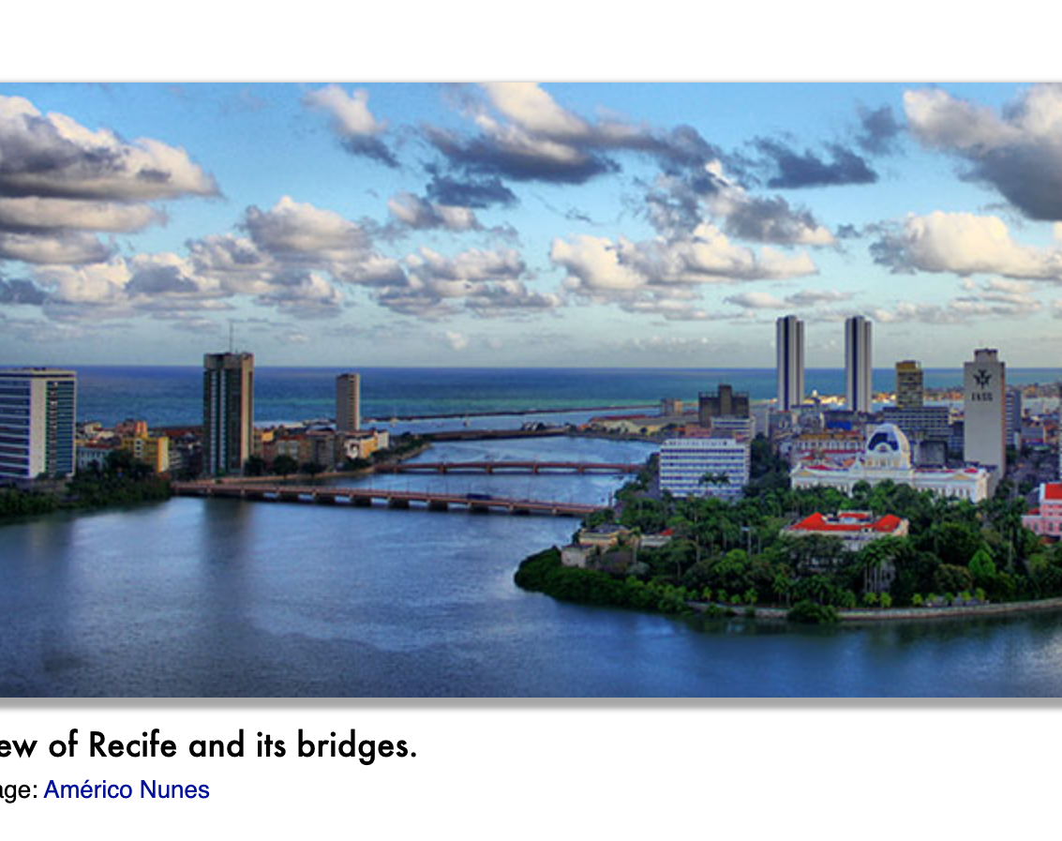
INTRODUCTION to citybikes api
API get request: retrieved from a city called Recife, in Brazil.
It is a city closer to the sea and is very famous for carnival.
I thought that I wouldn’t find a big network, but for my surprise I got 90 stations!

Slide 4
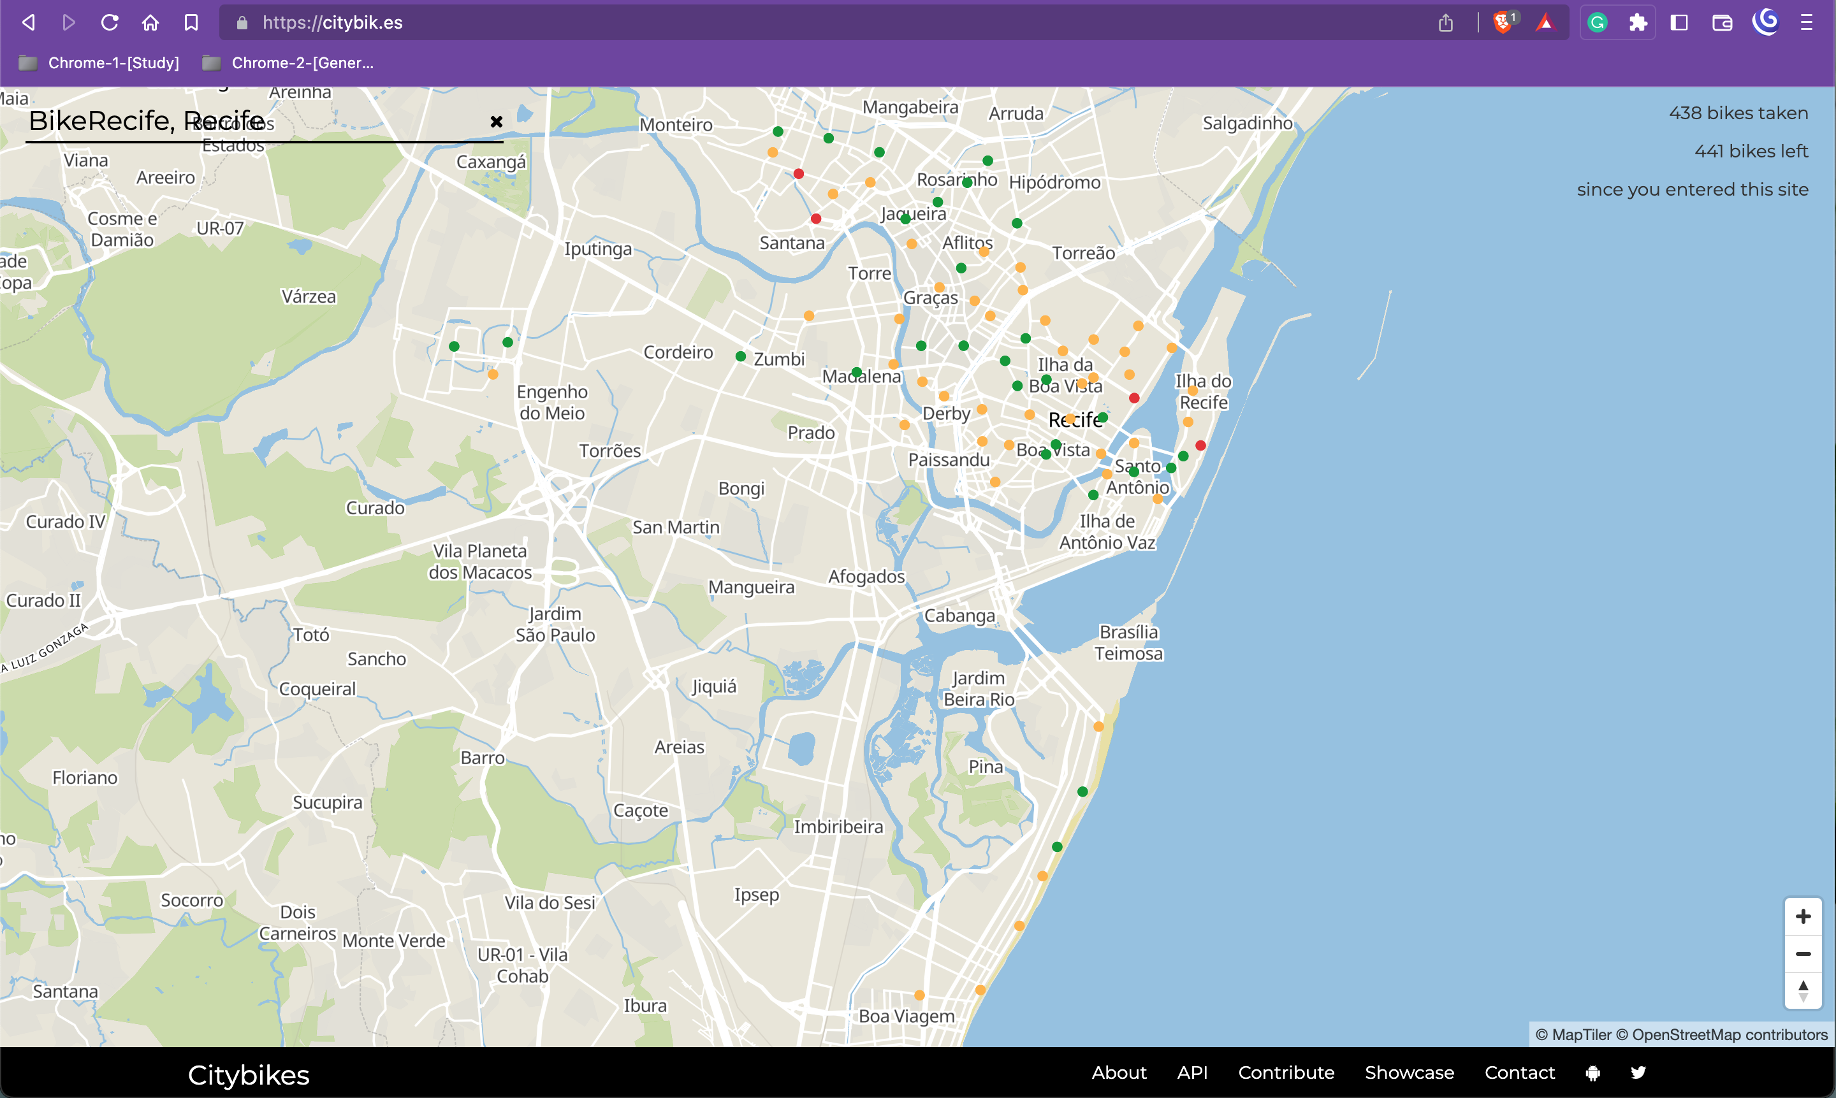

Slide 5
Visualization of the population and sample distribution
How to handle an accurate analysis of our 90 stations?
The sample was done from a for loop in Python. With that, I extracted 10% of the population randomly.
To check if it had the same distribution of the population, they were visualized with histograms.

Slide 6
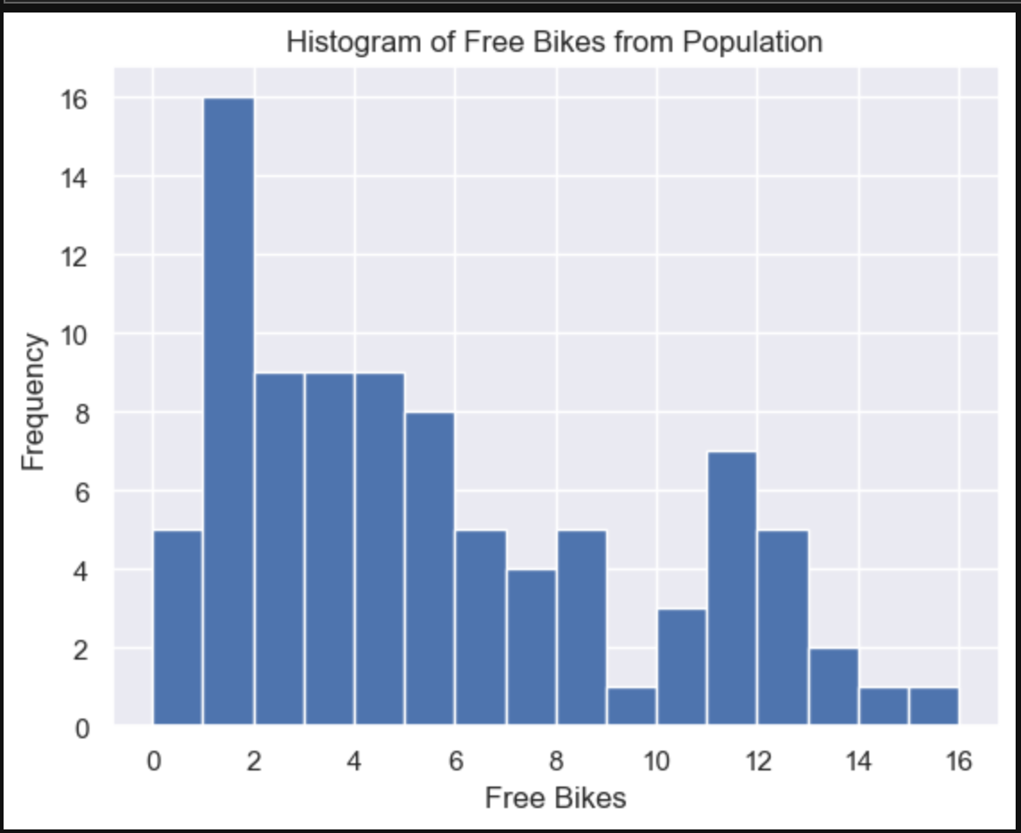
POPULATION Histogram

Slide 7
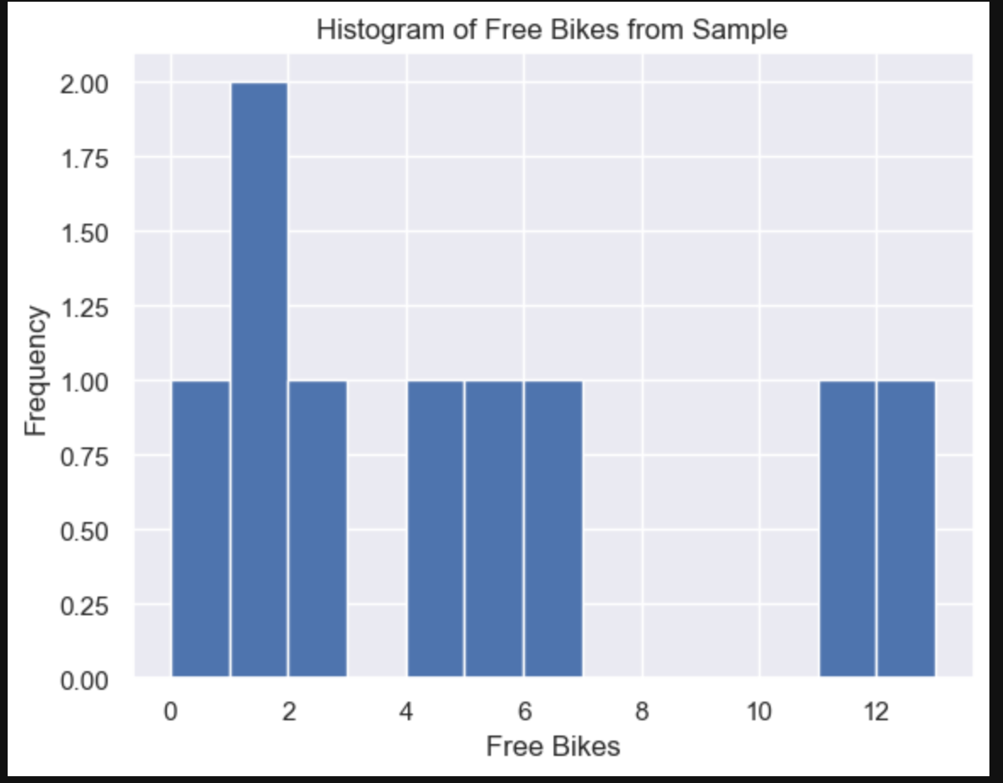
Sample histogram

Slide 8

CONNECTING WITH Foursquare and yelp api
Foursquare API: name, distance, address, latitude and longitude (filter: sort by rating: popularity)
Yelp PAI: name, address, latitude, longitude, rating and review counts (filter: sort by the best match)

Slide 9
Data Cleaning and transformation
Latitude and Longitude variables (sometimes matched, sometimes don’t by decimals)
Missing Data
NaN, Non-null and empty spaces.
Data Types
Float64 casted to int8.
Duplicates
Counting duplicated rows and kept with the 1rst record
Final merged with data from citybikes, fsq and yelp dataset: 10 columns and 200 rows
Obs.: before, we had 810 from Foursquare and 1476 rows from Yelp
Merging Columns
Dropping Columns
Variables data types changed: empty slots, free bikes, renting bikes and review count.

Slide 10
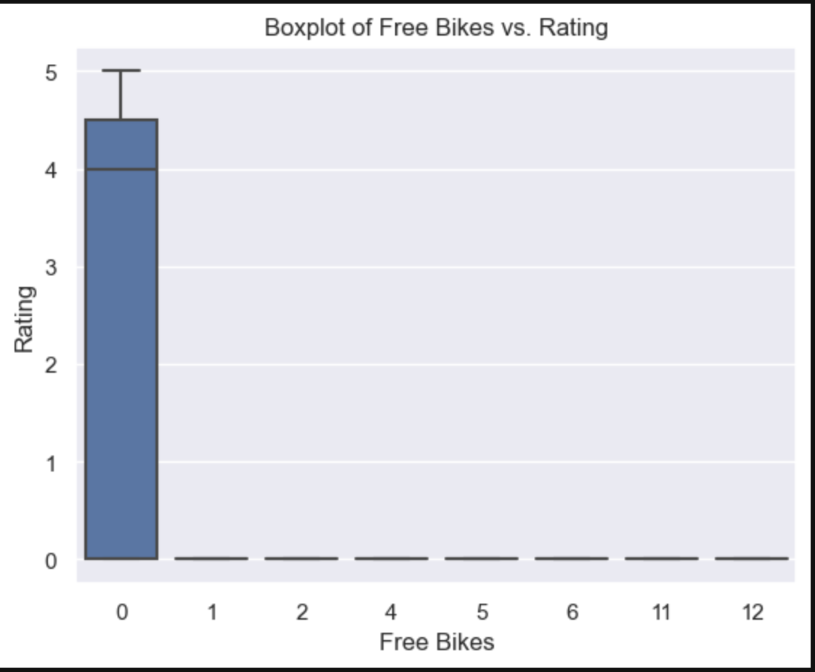
Relationship visualized during the eda

Slide 11
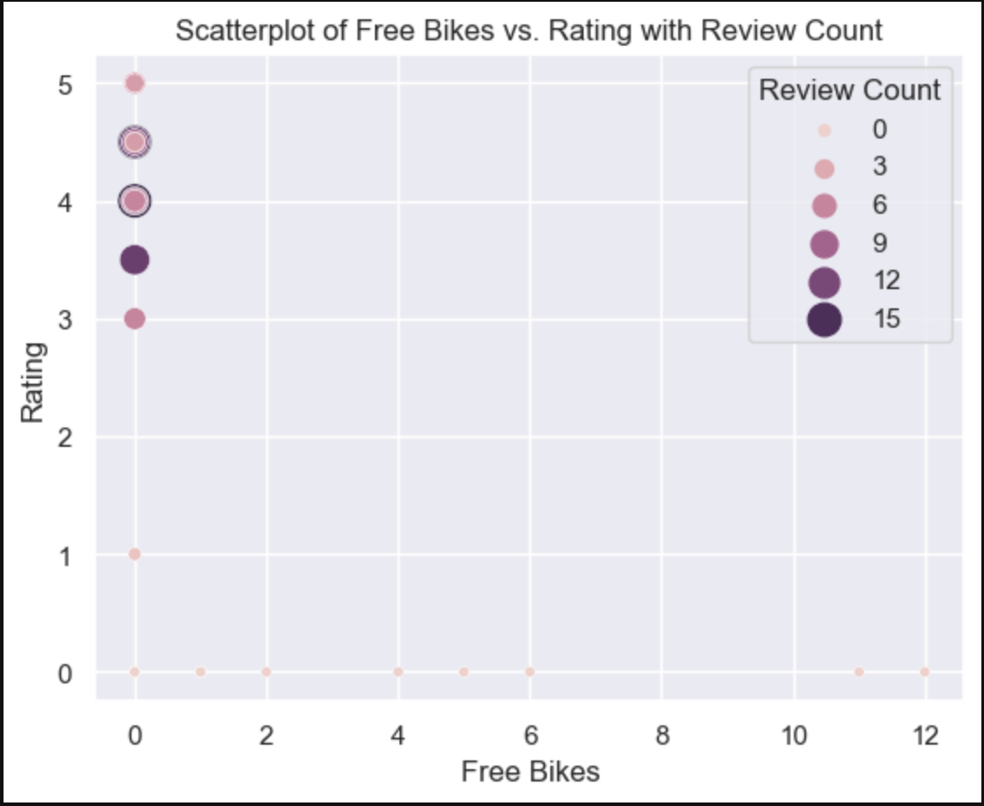
Relationship visualized during the eda

Slide 12
Analysis TIMELINE
1
During the EDA, it was possible to observe some patterns between free bikes, rating and review count of POIs. This led to the creation of the alternative hypothesis.

Slide 13
Hypothesis test
NULL HYPOTHESIS
ALTERNATIVE HYPOTHESIS
H0: There isn't a relationship between the variable free bikes and popular POIs in the area.
* For popular, it was used the rating and review count variables.
Ha: There is a relationship between the variable free bikes and popular POIs in the area.

Slide 14
Analysis TIMELINE
1
During the EDA, it was possible to observe some patterns between free bikes, rating and review count of POIs. This led to the creation of the alternative hypothesis.
2
Descriptive Statistics (with hypothesis testing): to find out more about the data using descriptive statistics

Slide 15
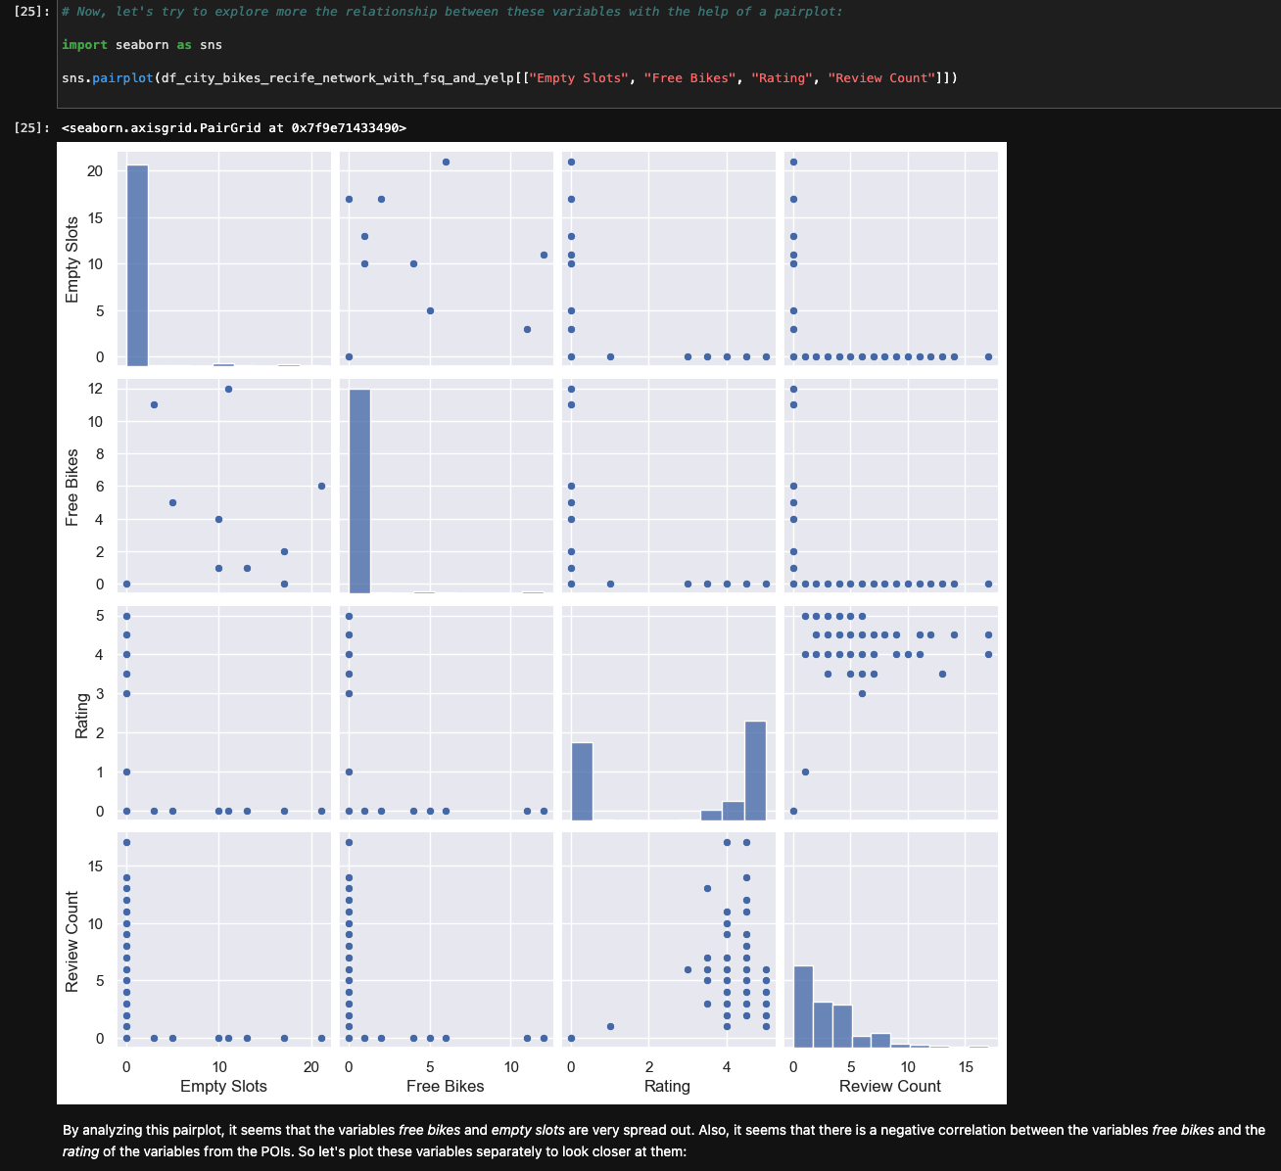
Descriptive statistics with hypothesis testing

Slide 16
Analysis TIMELINE
1
During the EDA, it was possible to observe some patterns between free bikes, rating and review count of POIs. This led to the creation of the alternative hypothesis.
2
Descriptive Statistics (with hypothesis testing): to find out more about the data using descriptive statistics
3
As we are trying to see if there is a correlation between the “free bikes” variable (as the dependent variable) and the rating and review count variables (as the independent variables), let's refer to the multiple linear regression model.
4
Multiple Regression Model

Slide 17
challenges
API and EDA
PARSING DATA
MODEL FIT
The data cleaning and transformation was performed cautiously; but it seems to me that because the APIs retrieved different parameters about the POIs it was a challenge to make connections between the data
More time consumed to parse and join data of different datasets than to analyze it.
Rating: interval (?) value
Review count: discrete value
How to consider this in the analysis? And how to find the best model fit?

Slide 18
THANK YOU

